Slide 1
Predicting Housing Affordability using the American Housing Survey

Slide 2
This Project
Use housing data to create a predictive affordability model
Tie the model to a web application so anyone can use it
Examine what is most important to the model in determining affordability
Shortcomings and potential fixes

Slide 3
The Data
American Housing Survey (AHS)
Conducted on odd numbered years by the Census Bureau
Contains tons of data on American housing stock
40710 samples in 2013
Publicly available with some information redacted for privacy
Housing Affordability Data System (HADS)
Created by Department of Housing and Urban Development (HUD)
Uses data from AHS
Measures affordability by relating housing cost to household income

Slide 4
COSTMEDRELAMICAT
“Housing cost at the median mortgage rate relative to area median income category”
“What percentage of the area median income would a household need to make in order to afford this housing unit?”
Assumptions:
Mortgage rate is the median rate of all AHS responses
maximum amount of income household can spend on housing cost: 30%
7 categories
1: <30%, 2: 30-50%, 3: 50-60%, 4: 60-80%, 5: 80-100%, 6: 100-120%, 7: 120%
Very hard to differentiate between neighboring categories

Slide 5
AFFORDABLE
Simplified variable based on COSTMEDRELAMICAT
Two categories
1: 0-100% of AMI needed to afford the unit
COSTMEDRELAMICAT categories 1-5
0: >100% of AMI needed to afford the unit
COSTMEDRELAMICAT categories 6-7
Easier to predict accurately
Nice Properties
“Is this unit affordable for the average person living in this city?”
Mean of AFFORDABLE variable for groups of data becomes the proportion of affordable units for that group

Slide 6
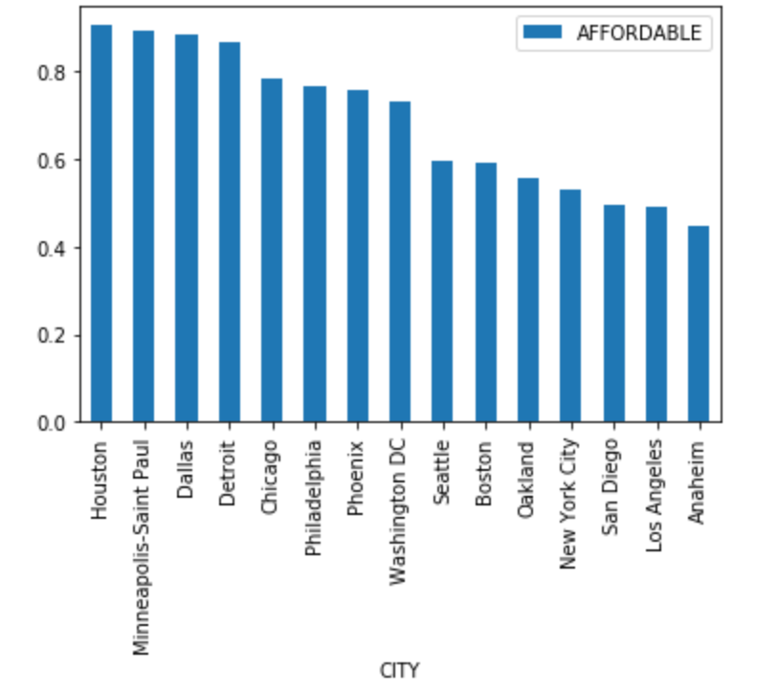
Affordability by City
California and New York least affordable
Midwest and Texas most affordable

Slide 7
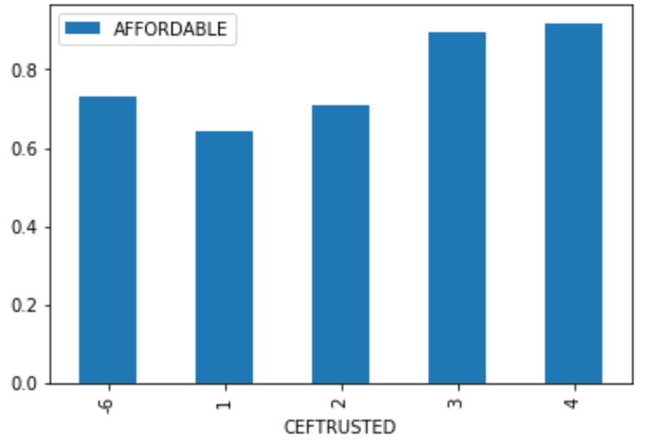
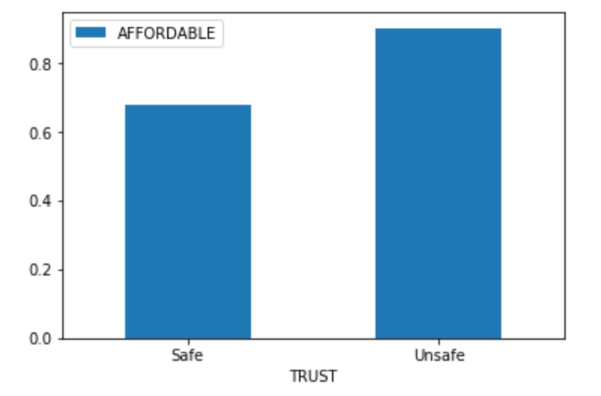
Affordability by Neighborhood Safety
CEFTRUSTED
Rating of neighborhood quality
From 1(best)-4(worst)
TRUST
CEFTRUSTED categories 1 and 2 -> “Safe”
CEFTRUSTED categories 3 and 4 -> “Unsafe”
Unsafe is 22.56% more affordable than Safe
P-value: 5.15*10^-52

Slide 8
The Affordability Predictor App
https://github.com/thewho14/Springboard
Download app.py and model.pkl
Run app.py
Visit http://127.0.0.1:8050/ on your web browser

Slide 9
Shortcomings
Locations too restricted
Could be fixed with access to the Internal Use File
Old data
2013 most recent but easily updated
National median mortgage rate creates potential bias towards affordability
More rural properties>lower value of units >lower rate

